Slide 1
BITS Pilani presentation
K.Anantharaman
kanantharaman@wilp.bits-pilani.ac.in

Slide 2
SE ZG544 – Agile Software Process
CS3 – Agile Manifesto & Agile Principles

Slide 3
CS3-Topics
The rise of knowledge workers
Agile Manifesto
Agile Principles
Team Motivation, Team Dynamics, Soft Skills
Self Organizing teams, Emergent Design
Simplicity

Slide 4

The rise of knowledge workers
Directive leadership style
Supportive leadership (Servant leadership style)
Source: lynda.com agile-foundations by Doug Rose

Slide 5
Agile Manifesto

Slide 6
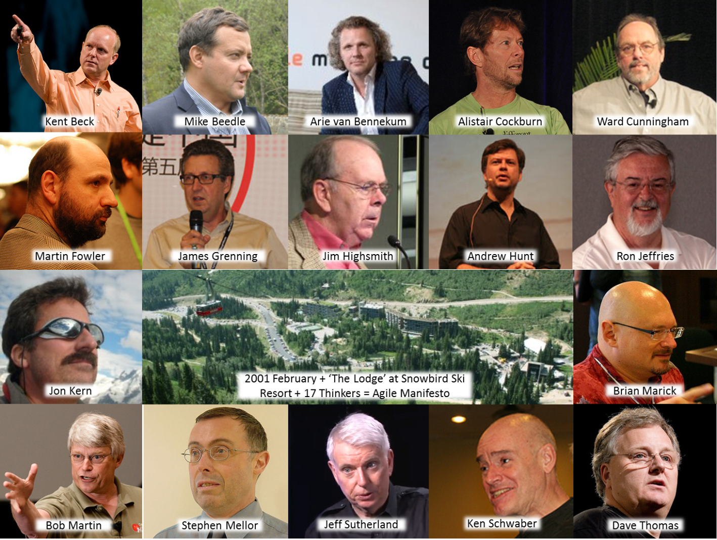
The Key Contributors
In Feb 2001, 17 new methodology pioneers met in Snowbird, Utah, USA.
To share their experiences, ideas, and practices and to suggest ways to improve the world of software development.
After Many discussions, they came up with Agile Manifesto
Image Source: https://udayanbanerjee.wordpress.com/category/agile

Slide 7
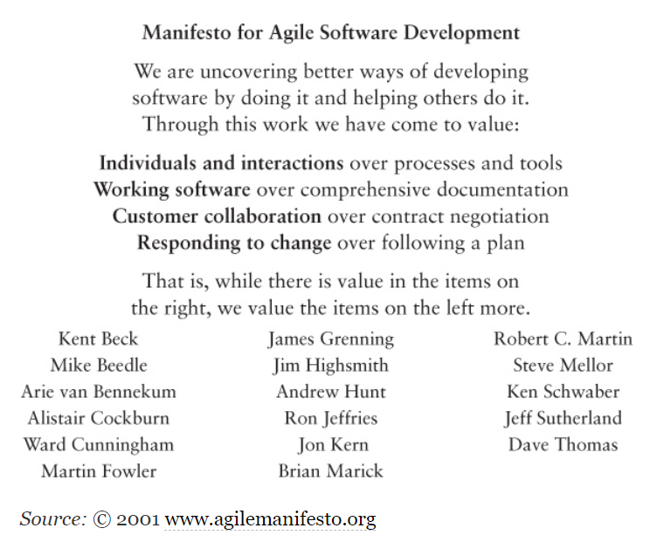
Agile Manifesto
Over the years, the Agile Manifesto has become a battle cry for organizational transformation.

Slide 8
Three Perspectives
(HOT Perspectives)
The Human perspective:
Cognitive and social aspects, and refers to learning and interpersonal (teammates, customers, management) Process.
The Organizational perspective:
Managerial and cultural aspects and refers to the workspace and issues that extend beyond the team.
The Technological perspective:
Practical and technical aspects and refers to Technical and Coding Practices.
Ref: Hazzan Dubinsky2008_Book_AgileSoftwareEngineering

Slide 9
Agile Manifesto Principles
(Year 2001)
https://agilemanifesto.org/
We are uncovering better ways of developing software by doing it and helping others do it. Through this work we have come to value:
Individuals and interactions over Process and tools (H)
Working software over comprehensive documentation (T)
Customer collaboration over contract negotiation (HO)
Responding to change over following a plan (OT)
That is, while there is value in the items on the right, we value the items on the left more.
Each principle supports and supported by other principles
Redefined roles for Developer, Manager, Customer
No “Big Upfront” Steps
Iterative Development
Negotiated and limited functionality
Focus on Quality – Achieved through testing
Ref: Meyer2014_Book_Agile

Slide 10
Agile Principles

Slide 11
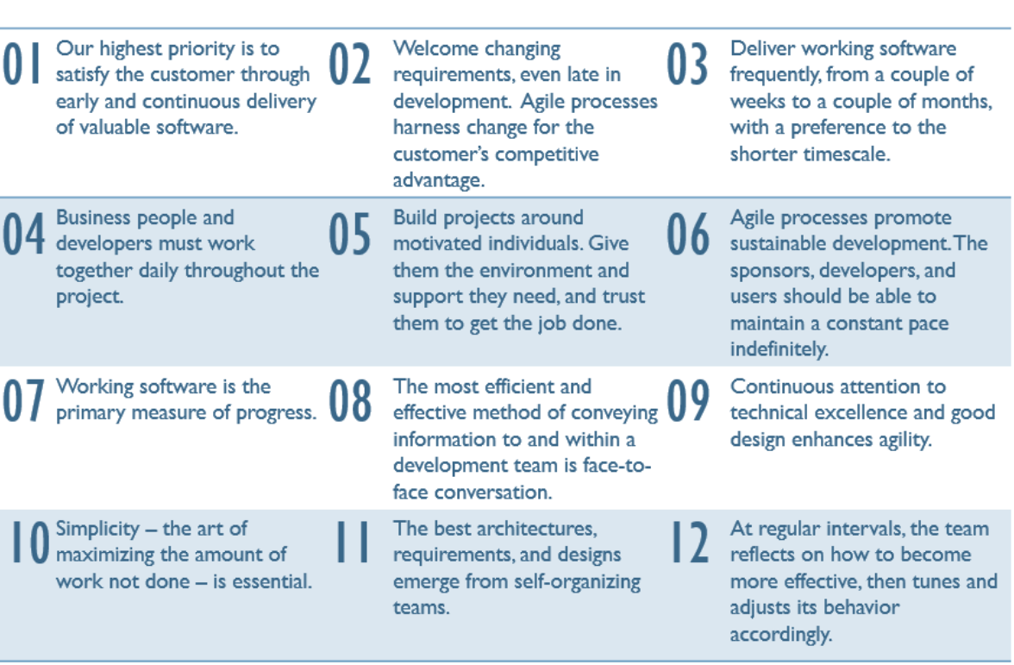
12 Agile Principles(Principles behind Agile Manifesto)
Satisfy Customer
Embrace Change
Frequent Delivery
Customer collaboration
Support & Trust
F2F Communication
Working software
Sustainable Phase
Technical Excellence
Keep it simple
Self Organization
Inspect & Adapt
https://nicocasel.net/blog/why-i-feel-natural-with-agile-principles

Slide 12
Augmentation of Agile Manifesto
Agile Manifesto was not actionable
To support teams making Agile transitions, actionable items were needed.
The original signatories of Agile Manifesto augmented the four values with 12 Agile principles behind the Agile Manifesto
Differentiate between Value, Principle, Practice
4 Agile values ,12 Agile Principles and many Agile Practices

Slide 13
Agile Principles (Not Official)
Organizational
1 Put the customer at the center.
2 Let the team self-organize.
3 Work at a sustainable pace.
4 Develop minimal software:
4.1 Produce minimal functionality.
4.2 Produce only the product requested.
4.3 Develop only code and tests.
5 Accept Change
Technical
6 Develop iteratively:
6.1 Produce frequent working iterations.
6.2 Freeze requirements during iterations.
7 Treat tests as a key resource:
7.1 Do not start any new development until all tests pass.
7.2 Test first.
8 Express requirements through user stories or scenarios.
Ref: Meyer2014_Book_Agile

Slide 14
Agile Practices
Agile Manifesto → Agile Principles → Agile Practices
Agile Practices → Project Outcome
Agile Practices
Sprint Planning, Product Backlog, Sprint Review, Planning Game, Frequent Delivery, Retrospective
Definition of Done
Whole Team, Osmotic Communication, Daily Scrum
TDD, Pair Programming, Continuous Integration, 10-minutes Build
Agile methods/methodologies
Scrum, XP, Kanban, Crystal

Slide 15
Quiz
Q1

Slide 16
Principle 1

Slide 17
Agile Principle#1
“Our highest priority is to satisfy the customer through early and continuous delivery of valuable software.”
Releasing software early
Shipping a working version of software as early as possible. by choosing the features and requirements that will deliver the most value. This is the best way to get customer feedback.
Delivering value continuously
The team that truly collaborates with customer has option of making necessary changes along the way. That’s what continuous delivery means. --- (vs CCB )
Satisfying the customer.
Plan short iteration, Deliver highest value, Early feedback, Incorporate feedback in next iteration. Collaborate with customer.
Source: The Agile principles By Andrew Stellman and Jennifer Greene

Slide 18
Agile Principle#2
“Welcome changing requirements, even late in development. Agile processes harness change for the customer’s competitive advantage.”
Requirements changes due to emerging/new opportunities
Respond to change instead of tight alignment to plans
Change satisfies the customer’s latest needs and provide the customer with a competitive advantage
Agile teams embrace change by treating project changes as positive and healthy developments for the project
Nobody gets in “trouble” when there is change, We don’t sit on the change until it is too late, We’re all together.

Slide 19
Agile Principle#3
“Deliver working software frequently, from a couple of weeks to a couple of months, with a preference to the shorter timescale.”
By using time boxed iterations to deliver working software frequently.
Shorter Iterations (~2 wks.) (Smaller releases means fewer chances of bugs , frequent feedback)
Agile teams constantly adjust the project so that it delivers the most value to the customer
We no longer regard a release cycle of “a couple of months” as agile. The industry has evolved to daily or weekly releases.
Source: https://www.plutora.com/blog/12-agile-principles

Slide 20
Agile Principle#4
“Business people and developers must work together daily throughout the project.”
Business people is referred to a Product Owner, or anyone who is a proxy between customer and team.
Emphasize here to have a shared responsibility and accountability, ‘work together’ stresses on total commitment on both sides.
Catching misunderstandings early, clarify requirements just-in-time and to keep all team members ‘on the same page’ throughout the development helps in producing successful outcomes.

Slide 21
Some list of customer satisfaction issues and Agile Approaches
Customer dissatisfaction issues | Agile Approaches
Product requirements misunderstood by the development team | The customer is able to provide feedback just-in-time and also at the end of the sprint, not before it’s too late at the end of the project.
The product wasn’t delivered when the customer needed it. | Working in sprints allows agile project teams to deliver high-priority functionality early and often.
The customer can’t request changes without additional cost and time. | Agile teams can accommodate change in requirements, and shifting priorities with each sprint, by removing the lowest-priority requirements –offsetting cost.
Source:T1

Slide 22
Agile Principle#5
“Build projects around motivated individuals. Give them the environment and support they need, and trust them to get the job done”

Slide 23
Motivated and Talented individuals
Source: Agile Foundations - Principles, practices and frameworks by Peter Measey
McGraw-Hill Education ACP Agile Certified Practitioner Exam by Klaus Nielsen

Slide 24
Motivated individuals
5th Agile Principle states “Build projects around motivated individuals …..”
Motivation releases energy and creativity and is an essential component of high performance.
We will look at a few different approaches to understanding what motivates individuals and the vital role that talent plays in achieving high performance.
We will look at psychological models

Slide 25
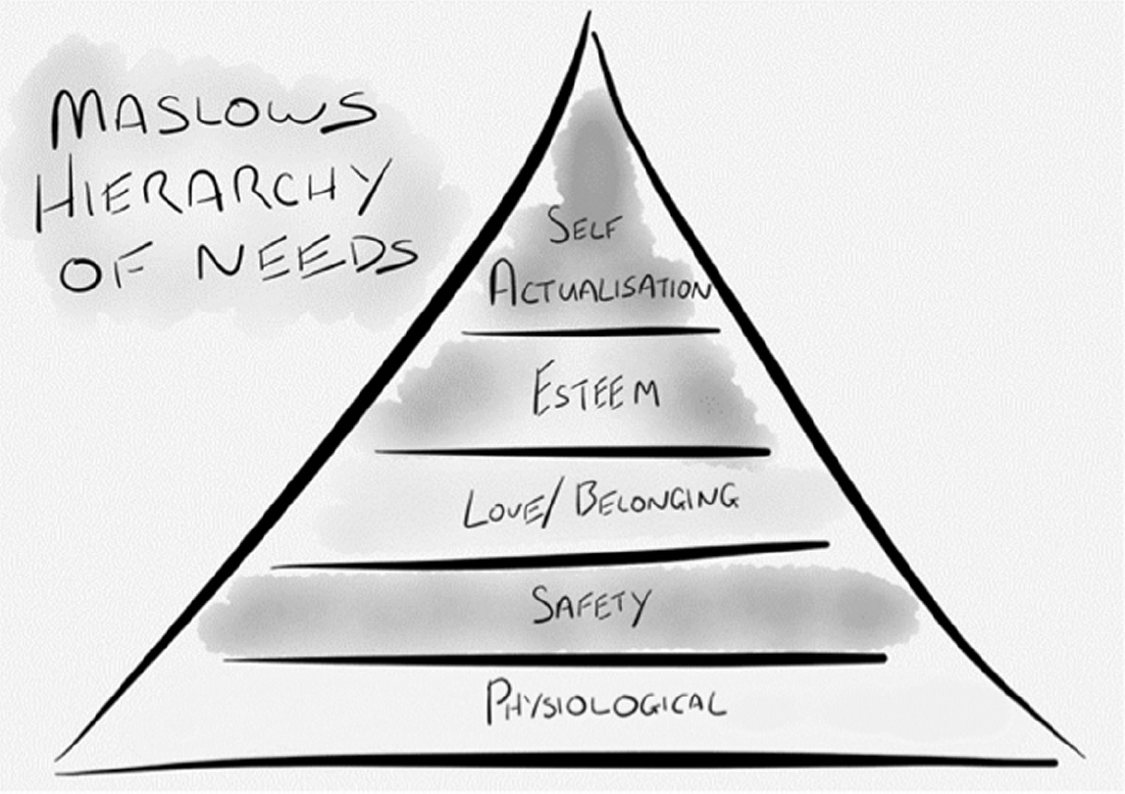
Maslow’s hierarchy of needs
(Motivation theory)
Maslow's hierarchy of needs is a theory in psychology proposed by Abraham Maslow in his 1943 paper still relevant today in 2020.
Maslow suggested that, once our basic needs are met, our behavior will be driven by meeting higher-level needs.
He assumed that human beings have the natural propensity to move towards self-actualization (Fulfillment of one own full potential/talents) by satisfying preceding needs.
Deficiency needs
Physiological : Human survival requirements, such as food, water and air, etc., comprise physiological needs. The absence of these will create various psychological symptoms, such as hunger, thirst, discomfort.
Safety: Physical safety, economic security, employment, health and wellbeing, and protection against accidents/illness.
Love/Belonging: The sense of belonging and acceptance, for instance in working groups, congregations, professional bodies and sports teams, can foster creativity and motivation.
Self Esteem/Respect :Sense of contribution, achievement, recognition, freedom and attention.
Self-actualization: ‘the desire to accomplish everything that one is capable of becoming’. Once individuals have achieved self-actualization they can provide their support to others.

Slide 26
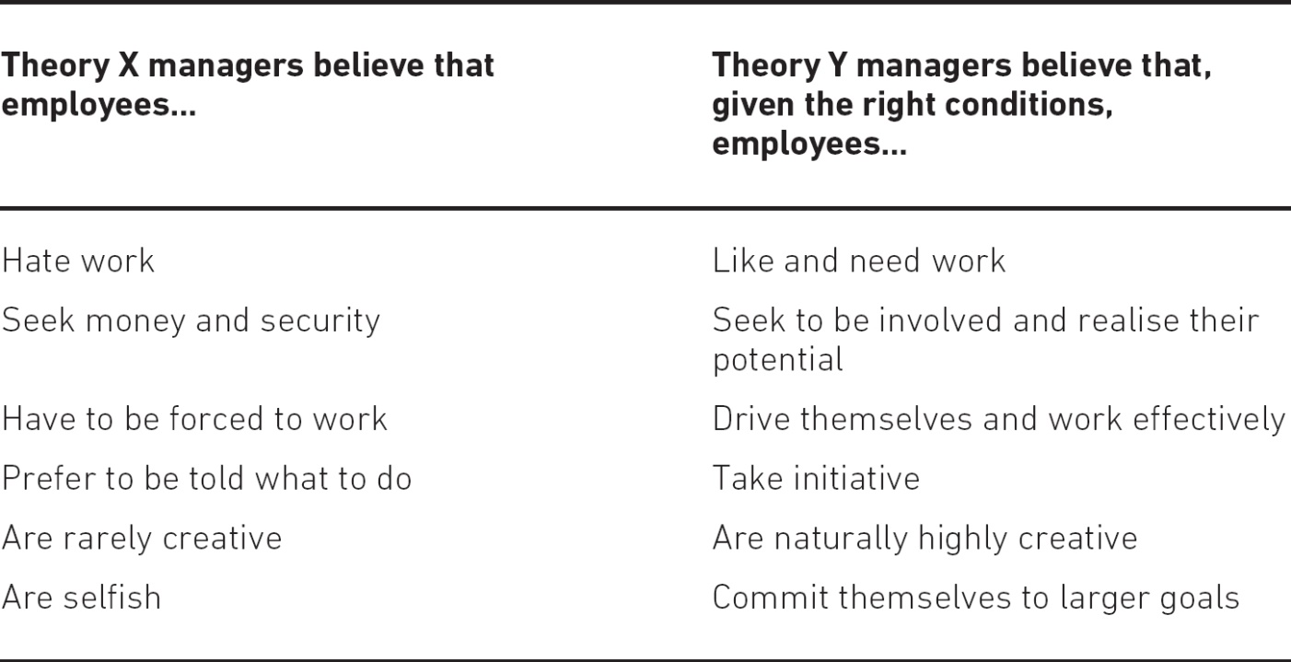
Management’s attitude determines motivation
McGregor’s Theory X and Theory Y
Whether employees display Theory X or Theory Y behavior is a consequence of how management treat them.
This means that generally managers will get what they expect – if they expect and manage for Theory X behavior, they will typically get employees displaying Theory X behavior.
An Agile leadership style should be in alignment with McGregor’s Theory Y, which views employees in a positive light.
As in Agile, that puts individuals and teams first, McGregor’s research outcomes prove that teams under Theory Y management showed better performance in comparison to Theory X teams.

Slide 27
Some factors only demotivate
A researcher Herzberg proposed a refinement to Maslow’s and an addition to McGregor’s approach
Hygiene factors comprise:
Pay, company policy, quality of supervision/management, working relations, working conditions, status and security.
Motivators comprise:
Achievement, recognition, responsibility, advancement, learning, type and nature of work.

Slide 28
Daniel Pink,2010 - Motivation comes from autonomy, mastery and purpose
Autonomy – people’s desire to direct their own lives and to gain control over some (or all) of the four main aspects of work: what, how, when and with whom.
Mastery – becoming better at something that matters to an individual. This can be achieved by taking on tasks that allow people to develop skills further. Mastery is fostered by an environment where learning is encouraged and mistakes are tolerated.
Purpose – fulfilling a natural desire in people to contribute to a cause greater than themselves.

Slide 29
Talent
To achieve high performance, motivation needs to be coupled with talent.
So where does talent come from? Are people born with it or can they acquire it? Matthew Syed argues for the latter, and states that (Syed, 2011):
Talent comes from purposeful practice
Practice needs to be purposeful.(Master at something)
Not all practice is useful. People only develop when they repeatedly try things that are just out of reach and get quality feedback on their performance.
The paradox of excellence is that it is built on necessary failure
The learning process is often best facilitated by an expert coach.
Engaging in purposeful practice leads to high performance – and the opposite is also true.

Slide 30
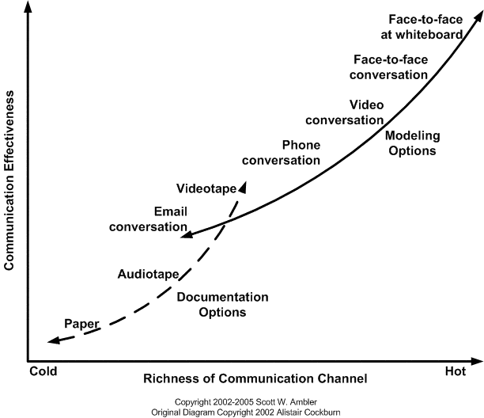
Agile Principle#6
“The most efficient and effective method of information to and within a development is face-to-face conversation.”
Remote teams:
Skype and Hangouts allow us to have remote face-to-face talks.
One-on-one communication has it challenges
Number of communication channels: N × (N–1)/2.
7 member team = 7*(7-1)/2=21

Slide 31
Agile Principle#7
“Working software is the primary measure of progress.”
Working software is better than progress reports, because it’s the most effective way for the team to communicate what they’ve accomplished.
Finished analysis, complete models, or beautiful mock-ups have may be necessary, But have little meaning if they aren’t converted into working software.

Slide 32
Agile Principle#8
“Agile processes promote sustainable development. The sponsors, developers, and users should be able to maintain a constant pace indefinitely.”
Agile work is intense.
Regular weekends, night outs, overtime not sustainable
The entire team is responsible for maintaining sustainable phase
Business owners or Product owners
The development team
Team Lead/Scrum master
Organization/Sponsors
Source: https://soulofscrum.com/blog/f/keeping-a-sustainable-pace

Slide 33
8. Sustainable Phase …
Product Owners (and other interested parties outside the Scrum Team):
Don’t make commitments to the business that don’t come from the Development team.
Don’t expect for the Development team to commit to anything longer term than the upcoming Sprint.
All prioritization comes through the Product Owner…respect that.
Keep in mind the cone of uncertainty when developing your Product Road Map.
https://soulofscrum.com/blog/f/keeping-a-sustainable-pace

Slide 34
8. Sustainable Phase …
Development Team:
Beware of estimating what you can get done in a sprint
By taking on too many backlog items into the Sprint Backlog you endanger having the time for creative solutions.
Cross training skills between team members
Worst of all the temptation of accepting lower quality for the Product Increment.
Collaborate with Product owner and prioritize the work
Source: https://soulofscrum.com/blog/f/keeping-a-sustainable-pace

Slide 35
8. Sustainable Phase …
Scrum Masters:
If you see the team overextending, ask them about this in the Retrospective.
Make sure there are no external pressures on the team.
Habitual or frequent overtime indicates an issue that you should investigate and remove as an impediment to team health.
Source: https://soulofscrum.com/blog/f/keeping-a-sustainable-pace

Slide 36
Agile Principle#9
“Continuous attention to technical excellence and good design enhances agility.”
Object Oriented design, Design patterns, Decoupled service-oriented architectures, Containers, Cloud technology and other innovations an tools bring technical excellence to product.
Well designed code is easy to maintain and extend.
Constantly lookout for design and code problems and take time to fix those problems.
Use TDD and pay back Technical Debt

Slide 37
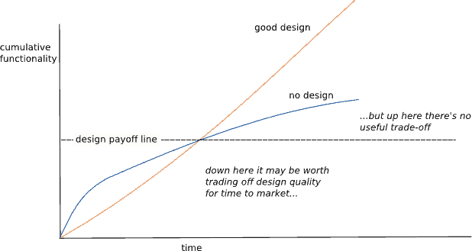
Technical Excellence
Technical debt is a term first coined by Ward Cunningham. It describes the accumulation of poor design that crops up in code when decisions have been made to implement something quickly. Ward described it as Technical Debt because if you don't pay it back in time, it starts to accumulate. As it accumulates, subsequent changes to the software get harder and harder. What should be a simple change suddenly becomes a major refactor/rewrite to implement.
Martin Fowler created a pseudo-graph to visualize this:

Slide 38
Q2

Slide 39
Simplicity
The art of maximizing the amount of work not done - 10th Agile Principle

Slide 40
Simplicity in Agile context
This means:
Focusing on ensuring that only the simplest, leanest and fit-for-purpose product is delivered, especially when considering lifecycle-driven documentation, and only producing what adds value.
Focusing on maximizing the amount of work not done when creating the product, i.e., focusing on simplicity of delivery

Slide 41
Fit-For-Purpose product
This principle is therefore about reducing clutter and keeping the backlog focused on whatever needs to be delivered first
Breakdown of features that are actually used in a typical delivered system (Standish Groups 2002).
Features always used – 7% → Deliver these features first
Features often used – 13%
Features sometimes used – 16%
Features rarely used – 19%
Features never used – 45%
Agile frameworks have the concept of producing technically fit-for-purpose products.

Slide 42
Fit-For-Purpose Delivery
This essentially means following Lean Software Development:
Eliminate Waste, Build in Quality, Create knowledge, Defer commitment, Deliver fast, Respect people, Optimize the whole
For example,
Eliminate waste:
Extra stories, stories constantly changing and the buffers created by crossing organization boundaries.
Build in quality
If defects are routinely found in the verification process, the development process is defective.
Defer commitment :
Abolish the idea that development should start with a complete specification
Optimize the whole:
Viewed across the whole value chain - Brilliant products emerge

Slide 43
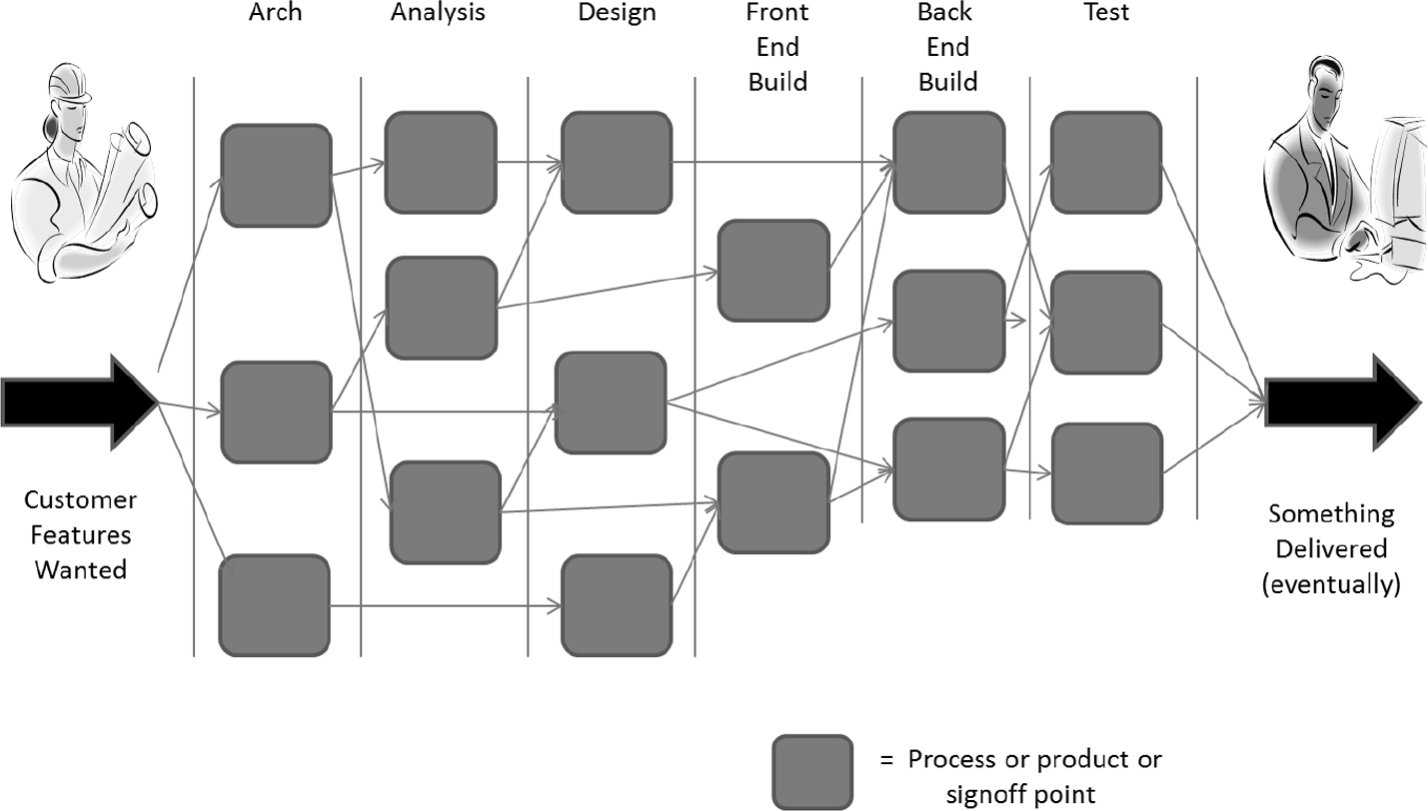
Silo Delivery
In a team working with a silo mentality , these unseen boundaries can easily become barriers to effective communication and delivery

Slide 44
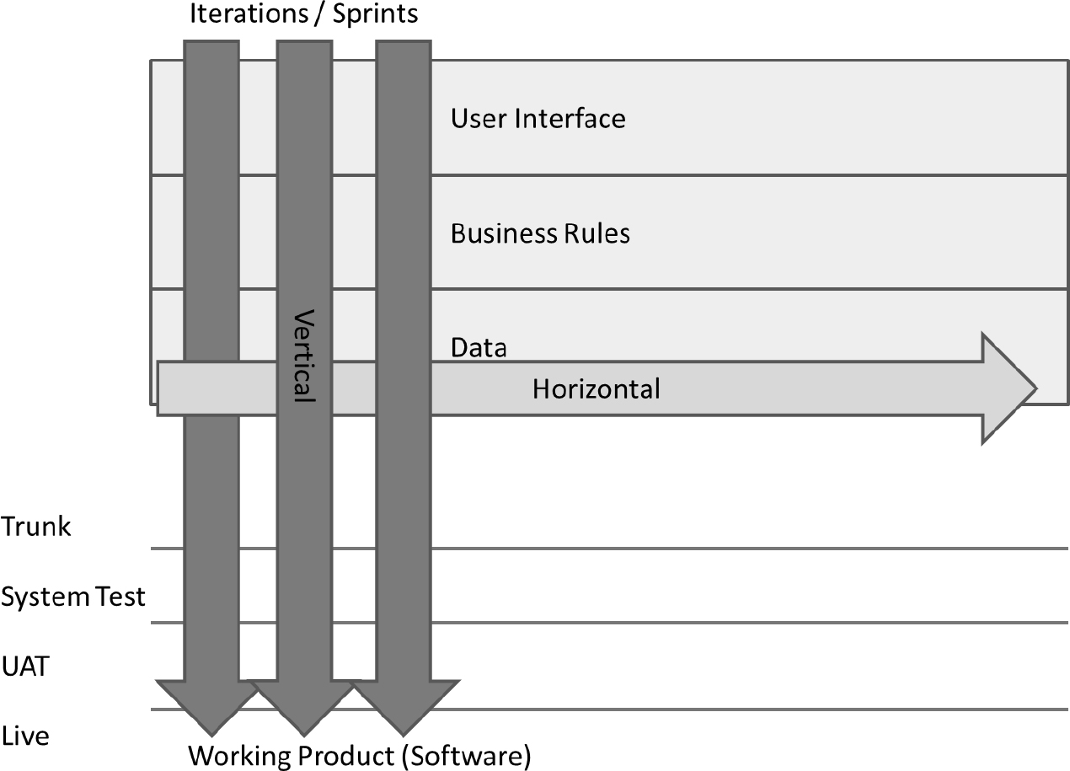
Vertical slices
In an Agile delivery teams focus on producing the highest value stories in vertical slices down the architecture.
Water fall thinking results in Horizontal slicing

Slide 45
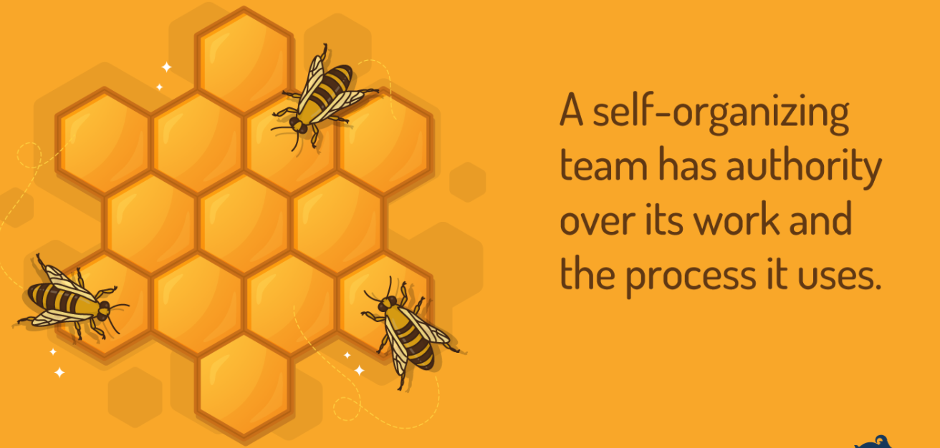
Agile Principle#11
“The Best Architectures, Requirements, and Designs Emerge from Self-Organizing Teams.”
Source: https://www.mountaingoatsoftware.com

Slide 46
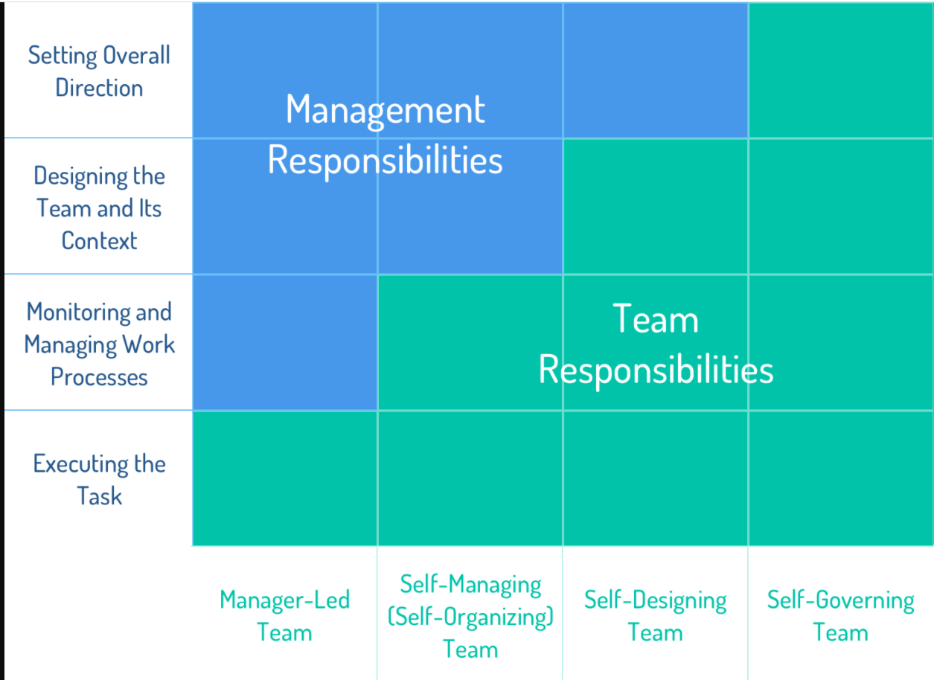
Type of teams
Source: https://www.mountaingoatsoftware.com

Slide 47
Self Organizing teams
Not every agile team will choose to organize themselves the same way
Some teams will decide that all key technical decisions will be made by one person on the team.
Other teams will decide to split the responsibility for technical decisions along technical boundaries
Still other teams may decide that whoever is working on the feature makes the decision but has the responsibility of sharing the results of the decision with the team.
Making use of the collective wisdom of the team will generally lead to a better way of organizing around the work than will relying solely on the wisdom of one personnel manager.

Slide 48
‘Emergent design’ – why is it important?
BDUF: Big Design Upfront
EDUF: Enough Design Up-front (Agile team implement this Approach)
Upfront design - restrict opportunities to change and improve the design as the product is being developed.
Wait until the last responsible moment to make design decisions
You can make decisions based on evidence that is identified as the system is being built. This typically means that decisions are of a higher quality, because they are not just theoretical decisions based on little evidence.
Example: Ordering a Hardware before lead time. The last responsible moment is governed by that lead time, and we have to find out enough about the hardware to make the order by that time, do some experimentations, gather required knowledge etc.

Slide 49
Self-organizing teams and emergent design
Self-organizing teams are empowered, within agreed boundaries, to deliver fit-for-purpose products, in a fit-for-purpose way, within the most effective time scale.
Self-organizing team in relation to emergent design is that there will be some overarching design principles that teams must or should align to the timescale.
If teams are forced to align to an externally defined detailed design they are unlikely to ‘go the extra mile’ to try and identify or implement any opportunities to make the design better (opportunistic design).
It is likely that the only people who can effectively make the right detailed design decisions are team members. Nobody else will understand the evolving design as well as the team does.
This ties in with the concept of ‘real options’ (Matts, 2007), which means keeping your options open for as long as you possibly can and making a decision when you are in the best position to make it with confidence.

Slide 50
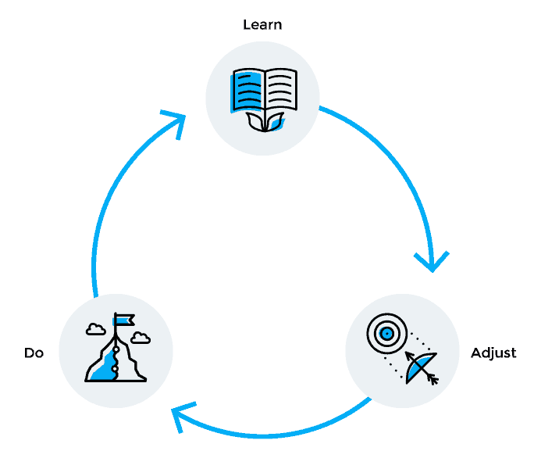
Agile Principle#12
“At regular intervals, the team reflects on how to become more effective, then tunes and adjusts its behavior accordingly.”
At regular intervals, self-organizing teams should take the time to look at the way they work and adjust accordingly. No team runs perfectly.
A mature agile team can identify issues with respect for each other and then take action to improve the process.
https://www.plutora.com/blog/12-agile-principles

Slide 51
Emergent Design From Self-Organizing Teams

Slide 52
Team Dynamics and Interpersonal skills

Slide 53
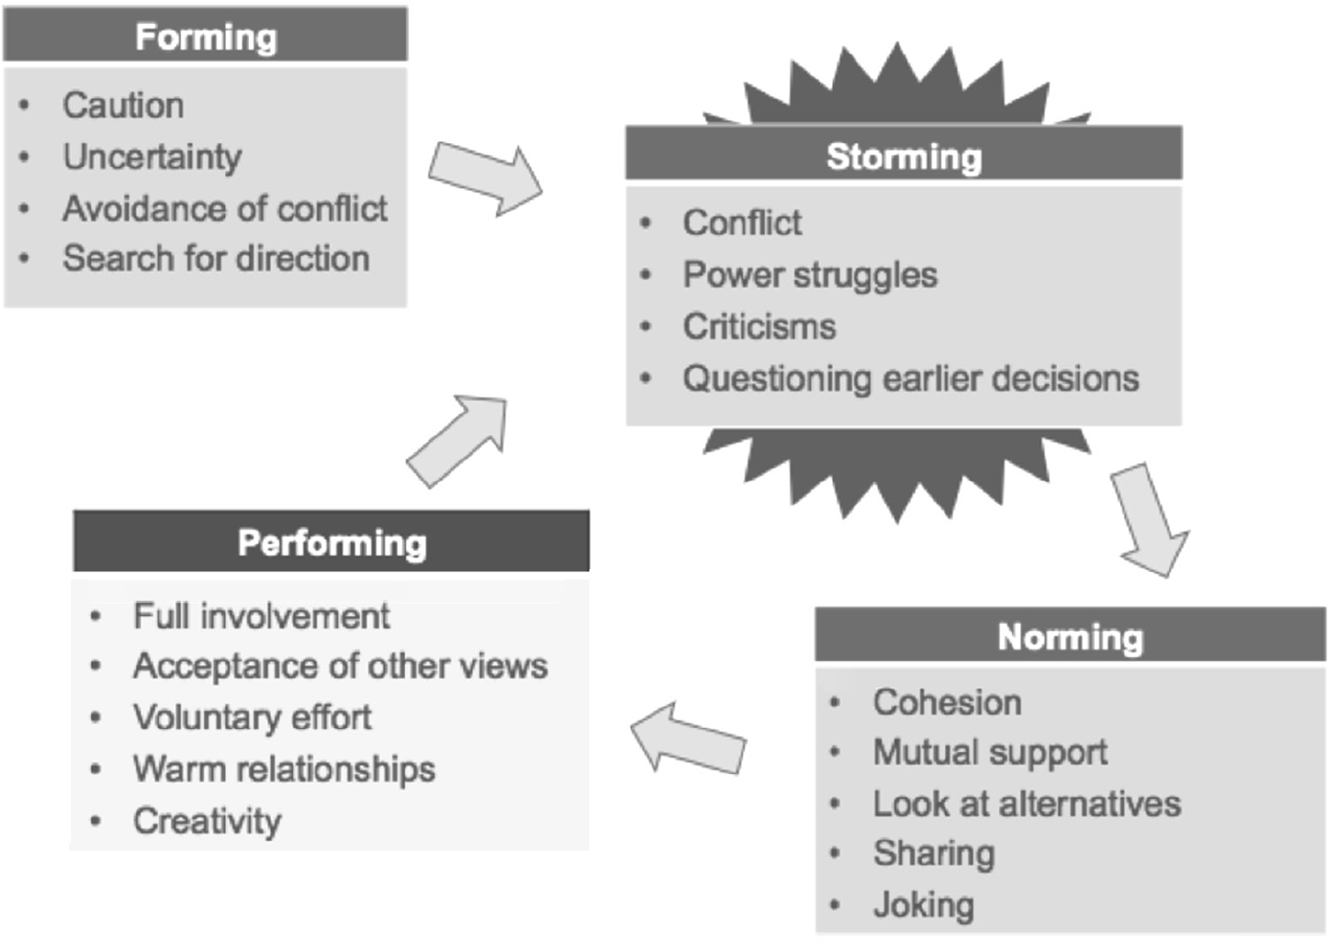
Tuckman’s theory of team evolution

Slide 54
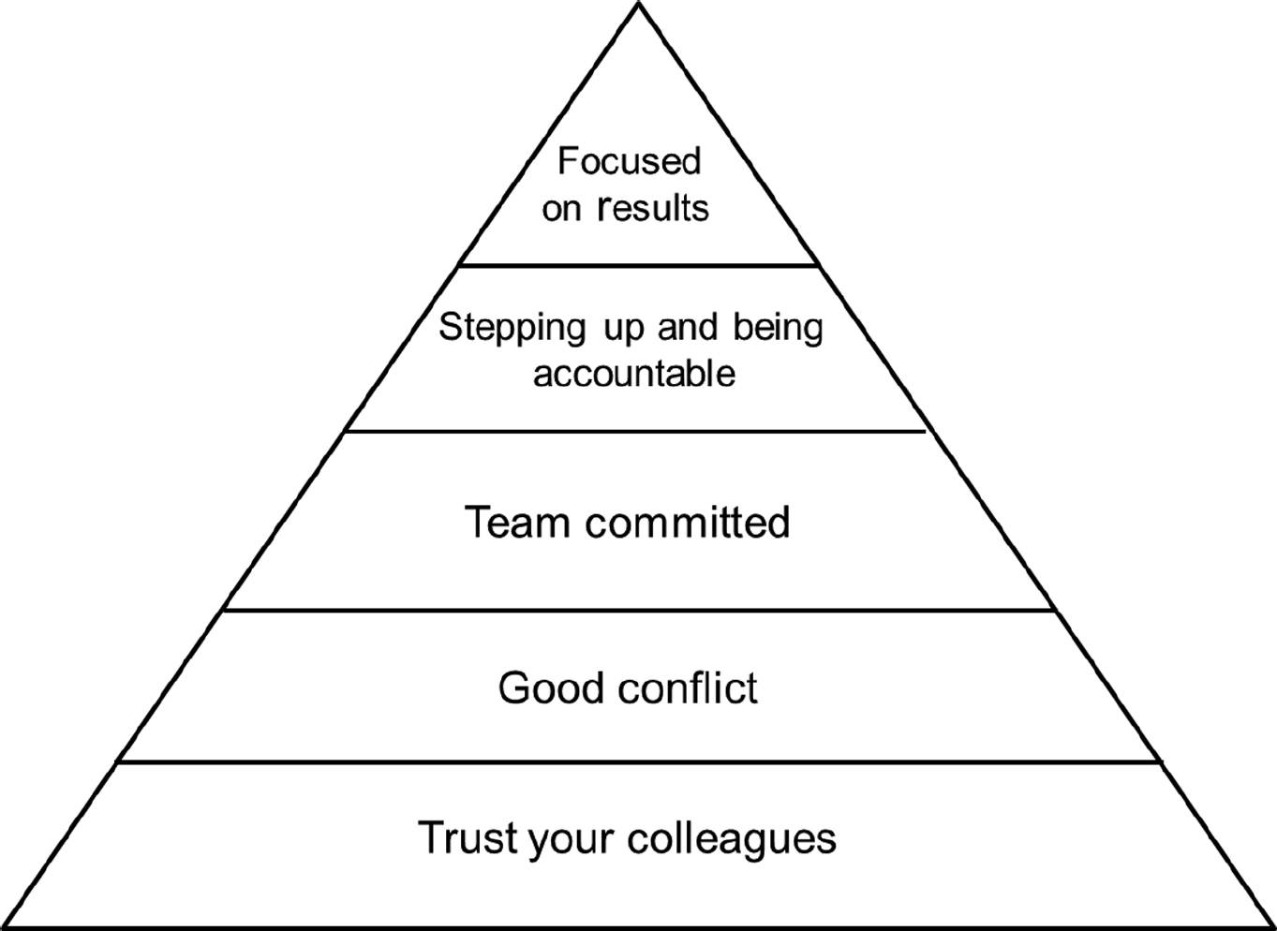
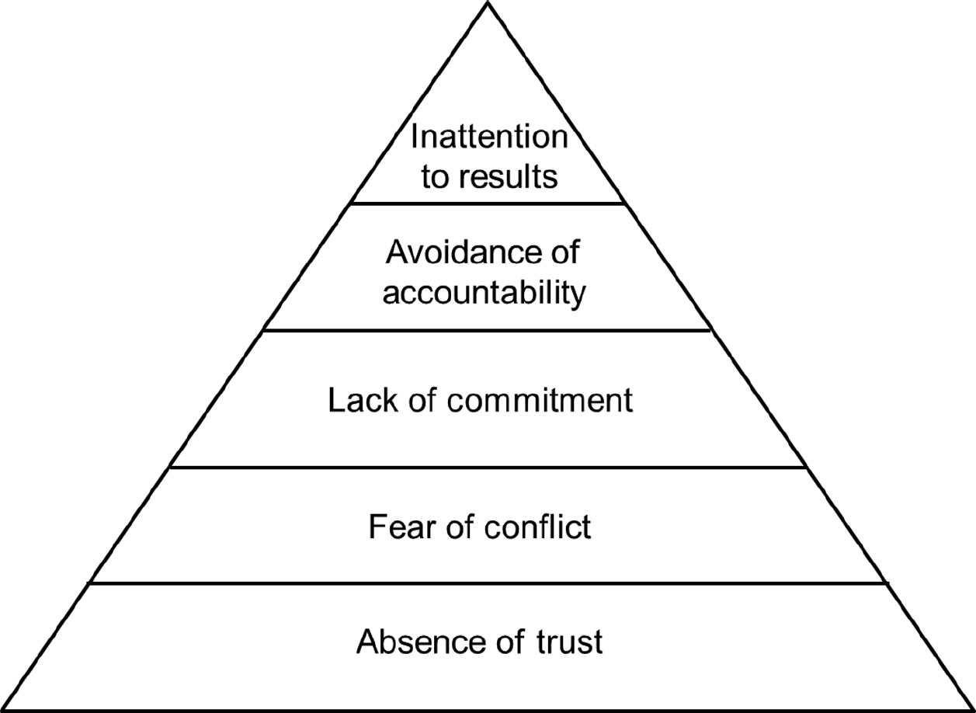
Lencioni – the five dysfunctions of teams
Dysfunction team
Functional high performance team

Slide 55
Interpersonal Skills – Key terms
Adaptive leadership A type of leadership that deals with changes and problem solving
Collaboration The action of working with someone to produce something
Conflict resolution Method(s) to solve conflicts
Emotional intelligence Focused on people and forging strong and supportive relationships
Negotiation Process of reaching the best results
Servant leadership A philosophy and set of practices that enriches the lives of individuals, builds better organizations and, ultimately, creates a more just and caring world

Slide 56
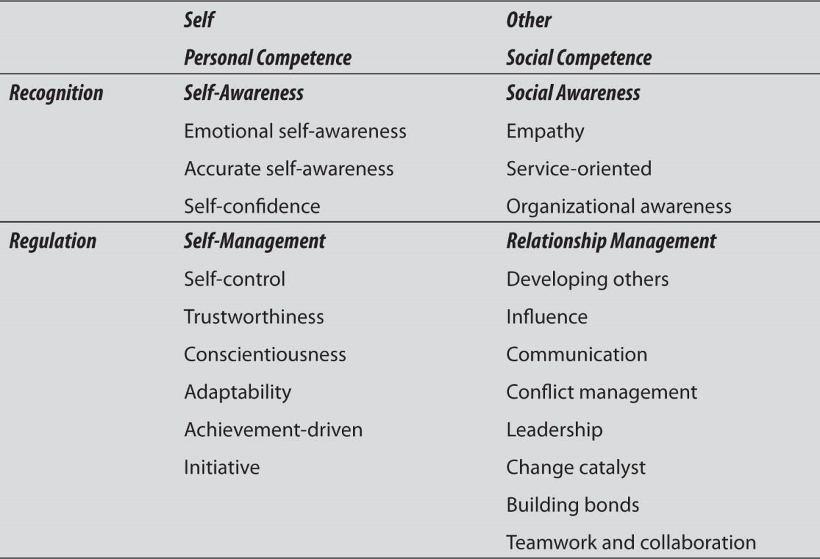
Emotional Intelligence
Emotional intelligence, in an Agile team, provides the team with the tools to make things work and the ability to perform well.
Mixed Model by Daniel Goleman
The higher the emotional intelligence of the Agile team, the greater are the chances for being successful in a people-oriented environment.

Slide 57
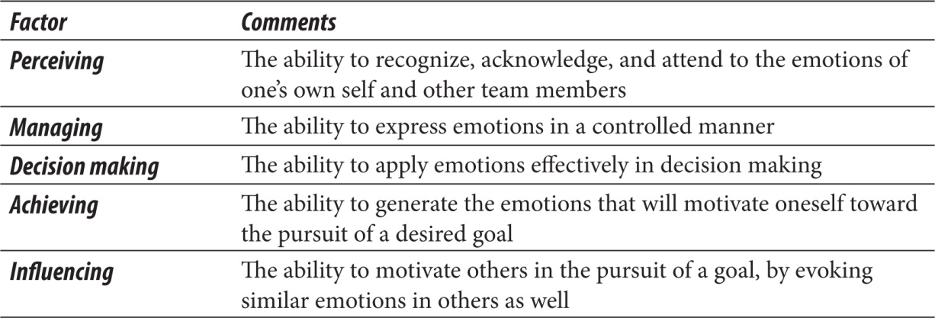
The Emotional Intelligence Skills Assessment (EISA) framework
Provides a strong fundamental assessment of emotional intelligence in project managers and Agile team members

Slide 58
Collaboration
Why do we collaborate and what factors contribute to effective collaborations?
We collaborate in order to deliver software (deliverables)
To foster progress by making decisions (decisions)
To learn (knowledge).
Cockburn and Highsmith (2002) identified collaboration as a combination :
Interpersonal (trust, participation, commitment, respect)
Cultural (values and principles)
Structural (organization, technology, and practices) values.
Agile practices encourage collaboration and coordination through:
Daily stand-up meetings, Daily interaction with the product team, Stakeholder coordination

Slide 59
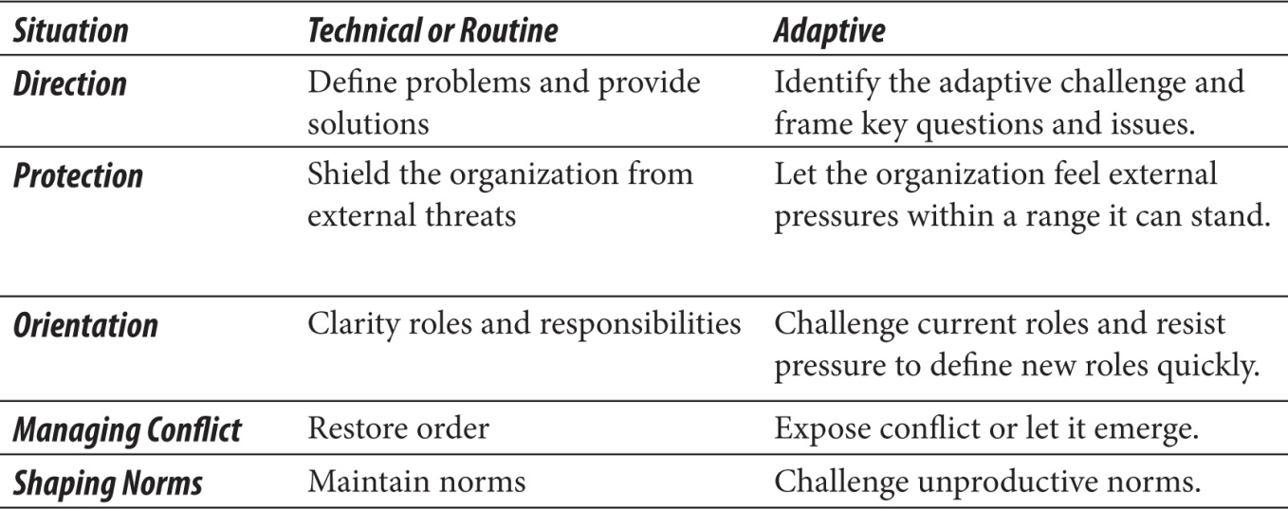
Adaptive Leadership
Adaptive leadership that deals with changes and problem-solving.
Adaptive leadership focuses on team management from building self-organized teams for developing servant leadership style.
Adaptive work, such as that embodied by Agile, requires adaptive leadership. Different situations call for different responses, there is a technical or routine response, and there is also an adaptive response

Slide 60
Negotiation
Fisher, Ury, and Patton (1991) call their approach “principled negotiation.” Their book, Getting to Yes, contains four key elements:
• Separate people from the problem
• Focus on interests, not positions
• Invent options for mutual benefit
• Use objective criteria

Slide 61
Conflict resolution
” The steps in conflict management may involve the following activities:
• Conflict identification
• Conflict analysis (who, what, why, when)
• Conflict resolution

Slide 62
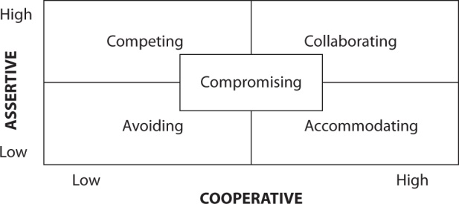
Conflict Resolution Techniques
The Thomas-Kilmann conflict mode and the five general techniques for solving conflicts are fairly similar. His five general conflict resolution techniques are:
Withdraw/avoid
Smooth/accommodate
Compromise/reconcile
Force/direct (compete)
Collaborate/problem-solve

Slide 63
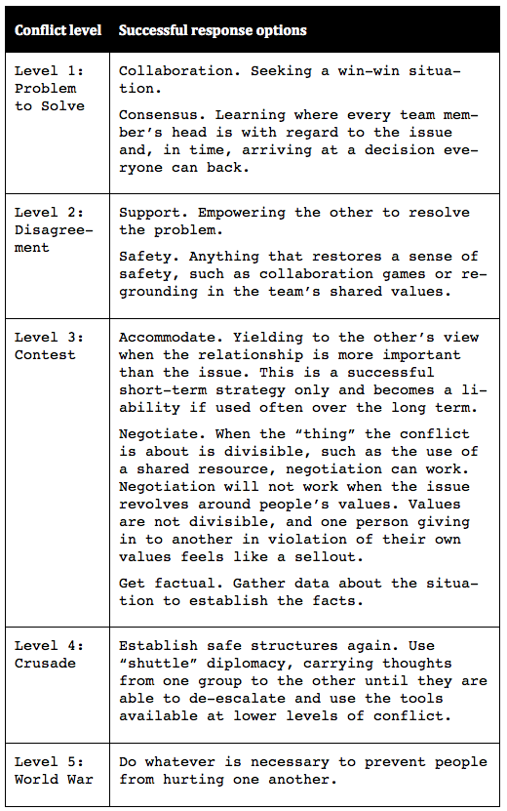
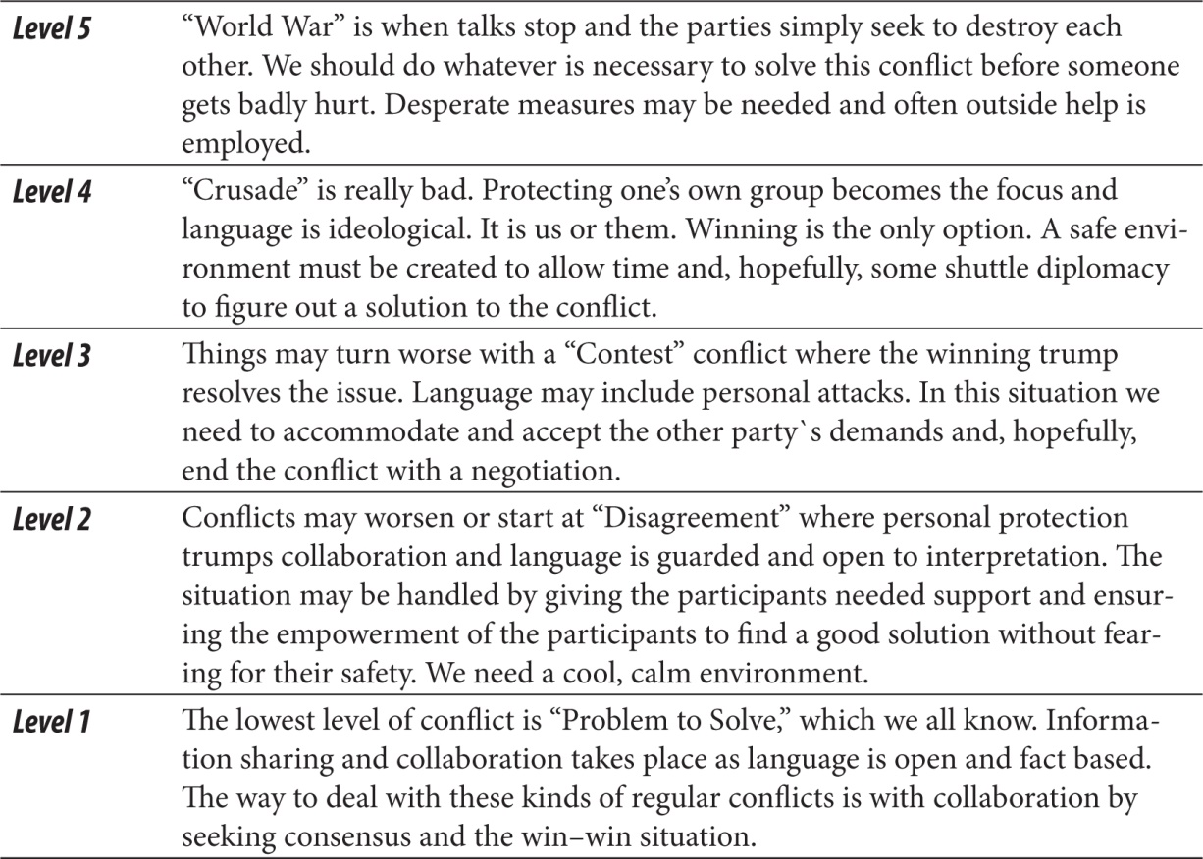
Conflict resolution
The book, Coaching Agile Teams (2010) by Lyssa Adkins, is popular in Agile circles and contains the following

Slide 64
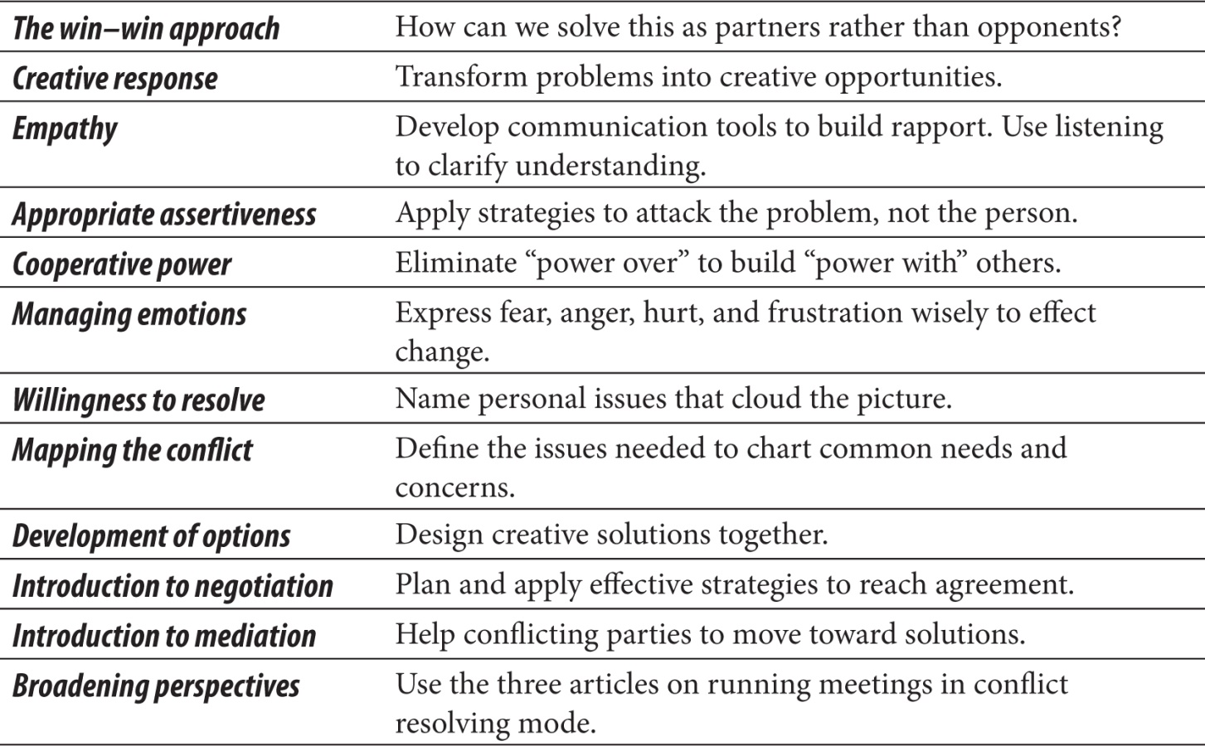
Conflict resolution skills
Conflict resolution an important factor of emotional intelligence, which more and more teams foster to improve the teamwork.
Communication, active listening, negotiation skills, and soft skills all play an important part in Agile methodologies, as teams are self-governed and empowered.

Slide 65
Servant Leadership
The core characteristics of being a servant leader are:
Listening
Empathy
Healing
Awareness
Persuasion
Conceptualization
Foresight
Stewardship
Commitment to the growth of people
Building community
The emphasis here is on four factors
• Get the right people into the team.
• Trust team members rather than requiring them to prove themselves trustworthy
.• Let the team select the project approach for project success
• Stand back and let the team do their work.

Slide 66
Anti Patterns: Agile Manifesto
The tool makes us Agile, Relentless automation
Hierarchies
Over-standardization
Proxy customers (Business Analysts, Architect acting as customer)
Considering plans and roadmaps as commitments
Expecting too much detail
Not engaging stakeholders

Slide 67
Q3

Slide 68
Anti Patterns: Agile Principles
Out of sight, out of mind - Stakeholders
Requiring additional documentation or reporting, "We will need this later", Documentation as collaboration, Write only documentation
One size fits all approach towards team management
Chasing the metrics
Ignoring the environment
Multiple deployment environments
Detailed story descriptions, Fixed standards or Process, Aiming for Small stories on the backlog
Restricting who can talk to the customer
Not considering cultural differences
Lacking collaboration skills
Over-complicating things/Future proof everything
Insisting on Sign-off Process
"Just in case" development
Management focus on individuals
Iterations planned in advance
Focus on the tasks not the value

